Slide 1

OCTOBER 6 UNIVERSITY
Airline Passenger Satisfaction Predictive Modeling
Faculty of Computer Science and Info. Systems
Team: Youssef Hassan, Adham Mohamed, Mohamed Essam, Mohamed Wessam, Hazem Mohamed, Ahmed Nasser, Nora Ahmed Supervisors: Dr. Nagwa Yassin, Eng. Hend Maher, Eng. Doaa Ali

Slide 2
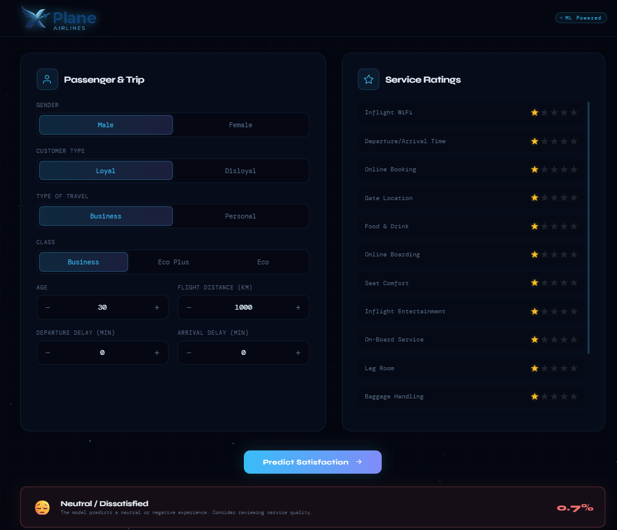
Problem Definition
The airline industry is highly competitive, where satisfaction drives brand loyalty and revenue.
Objective: Build a binary classification pipeline to predict passenger satisfaction (satisfied vs. neutral/dissatisfied).
Proactive Action: Predicting dissatisfaction early allows airlines to proactively address complaints.
Operational Insight: Identifying key service dimensions enables targeted improvements.
Deployment: Instantly evaluate new passenger profiles via a Streamlit web interface.

Slide 3








Goals & Objectives
Profile & Clean
Analyze & Train
Evaluate & Deploy
Process raw airline survey data, handle missing values, and ensure structural integrity before modeling.
Conduct EDA to surface patterns, engineer features, and train ANN, Random Forest, and XGBoost models.
Select the best-performing model based on test metrics and deploy via an interactive Streamlit web application.

Slide 4


Dataset Overview
Attribute | Details
Source | Airline Passenger Satisfaction Survey (Kaggle)
Target Variable | satisfaction (binary: satisfied / neutral or dissatisfied)
Total Features | 22 features after preprocessing
Feature Types | Demographic, operational, and ordinal service ratings (0-5 scale)
Missing Values | Sparse (< 0.3% rows); resolved by listwise deletion
Duplicates | Zero confirmed after deduplication check

Slide 5




Methodology Pipeline
4. Splitting & Scaling
2. Outlier Removal
Applied Interquartile Range (IQR) method to clip extreme delays and distance values.
Stratified Split (70 Train / 10 Val / 20 Test) and StandardScaler fit exclusively on training data.
1. Quality Checks
3. Feature Encoding
Verified missing values, dropped duplicates, and validated data types (float32 casting).
LabelEncoder for categorical features; mapping saved as dicts for Streamlit inference.

Slide 6
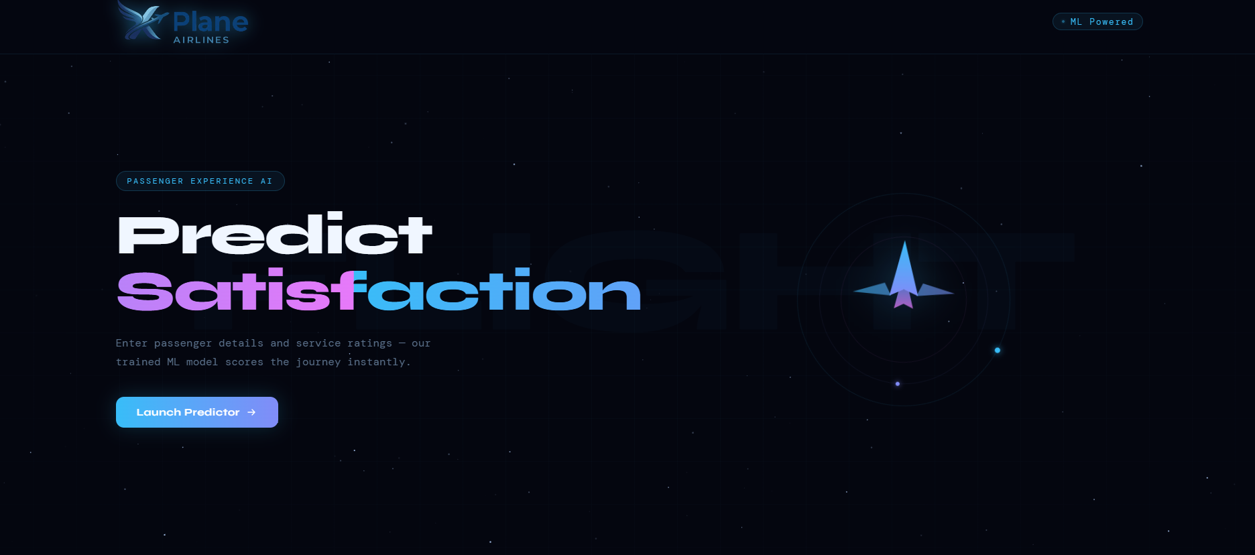
System Design
Offline Training & Online Inference
The system couples a reproducible Jupyter Notebook training pipeline with a real-time Streamlit web app.
Exported Artifacts for Deployment:
•
best_model.pkl (Winning estimator)
•
input_scaler.pkl (Feature normalization)
•
class_encoder.pkl (Label mappings)
* Note: Use this layout to showcase Figure 1 or 2 (Prediction Interface/Input Panel) from the report.

Slide 7
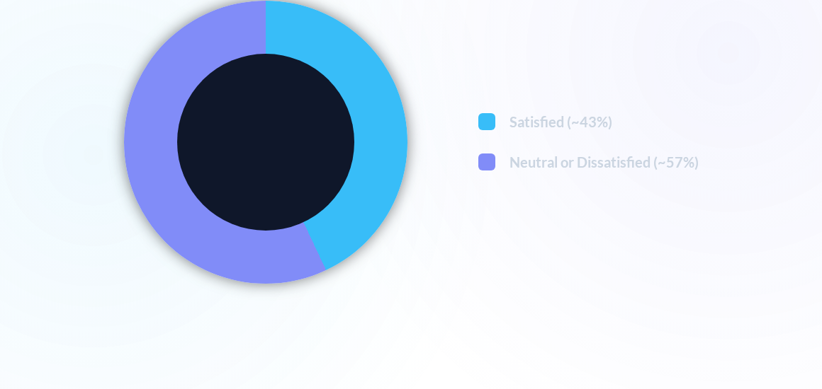
EDA: Class Distribution
The target variable is moderately balanced. This balance means overall accuracy is a highly reliable primary metric, complemented by macro-F1 to confirm per-class performance.

Slide 8


Key Exploratory Insights
Categorical Segments
Numeric Correlations
Class & Travel Type: Business class passengers and Business travelers exhibit markedly higher satisfaction rates compared to Economy or Personal travelers.
Delays: Departure Delay and Arrival Delay are strongly correlated (r > 0.9), as expected operationally.
Service Dimensions: Strong positive correlations exist among service ratings (e.g., Seat Comfort & Cleanliness), showing interrelated passenger perceptions.
Loyalty: Loyal customers show higher satisfaction, likely reflecting selection bias toward passengers who prefer the airline.
* Note: Figure 4, 5 (Categorical) or Figure 8 (Correlation Heatmap) can be discussed alongside these points.

Slide 9
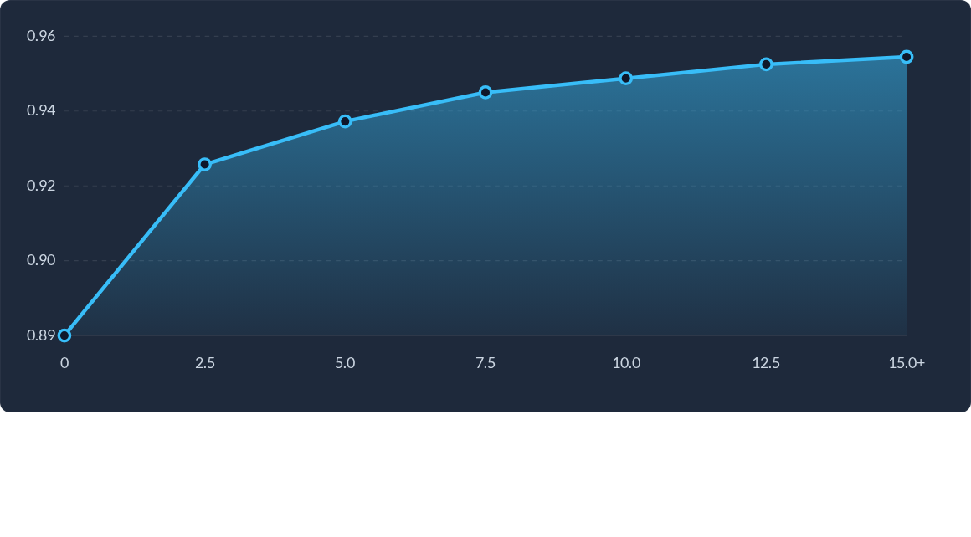
ANN Training History (Accuracy)
Training up to 50 epochs with EarlyStopping (patience=5). The curve demonstrates rapid learning in early epochs before stabilizing >95%, preventing overfitting on the validation set.

Slide 10
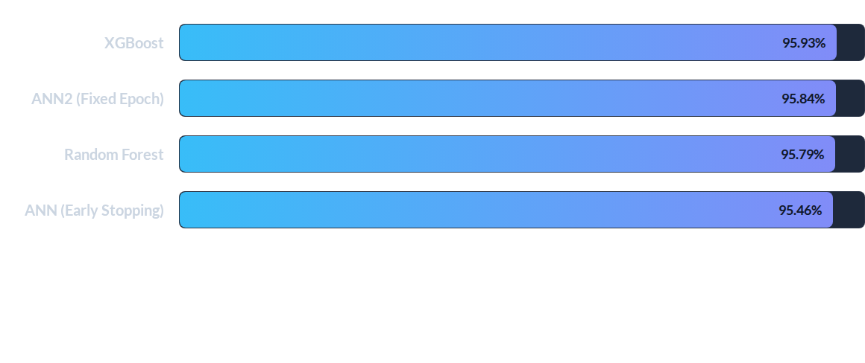
Model Comparison: Test Accuracy
XGBoost achieved the highest accuracy. The near-parity (< 0.5% margin) suggests the dataset is highly informative and well-suited for both deep learning and tree ensembles. Macro F1 scores consistently hovered around 0.96.

Slide 11



Future Improvements
Model Tuning & Calibration Apply Platt scaling for better confidence scoring. Use Optuna or Bayesian optimization to systematically search hyperparameter spaces for ANN and XGBoost.
Explainability (SHAP) Compute SHAP values for tree models to explain individual predictions and identify the absolute top service drivers of dissatisfaction.
Feature Engineering Construct interaction terms (e.g., Class x Wi-Fi) and aggregate satisfaction by route or aircraft type to surface specific operational patterns.

Slide 12
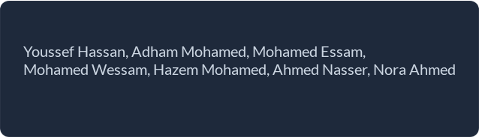
Questions?
Thank you for your attention.
Team Members:
October 6 University | Faculty of CS & IS

Slide 13


Image Sources
https://framerusercontent.com/images/schDoamnA5b6R8z6M8CaosoO4sk.jpg?width=2508&height=1672
Source: mavenanalytics.io
https://datalend.com/wp-content/uploads/2023/10/Data-Analytics-%E2%80%93-DataLends-New-User-Interface-4.png
Source: datalend.com

